Slide 1


SQL Learning Journey: Exploring Population Data
By Swapna Macha

Slide 2
Contents
Project Brief
Dataset Overview
Problems or challenges in the Dataset
Data Cleaning and Transformation Process
Insights and Findings

Slide 3
Project Brief
Explored a comprehensive global demographic dataset to analyze trends and patterns.
Used SQL to query and process structured data effectively.
Focused on deriving actionable insights for practical applications, including:
Urban Planning: Identified population density and growth trends to aid infrastructure development.
Economic Research: Analyzed GDP and life expectancy data to evaluate economic performance across regions.
Travel Recommendations: Highlighted key cities and countries based on socio-economic factors for travelers and businesses.
Aimed to uncover relationships between demographic variables to inform decision-making.
Demonstrated proficiency in SQL for advanced data querying and analysis techniques.

Slide 4
Dataset Overview
The project focuses on analyzing global demographic data to uncover trends and insights
Focused on key metrics such as population, GDP, life expectancy, and urbanization patterns.
The dataset includes diverse fields such as cities, countries, and various socio-economic indicators.
By leveraging MySQL, this project aims to demonstrate advanced querying techniques and provide actionable insights from structured data.

Slide 5
Identified Problems or Challenges in the Dataset
Managing large-scale data efficiently.
Lack of data for specific queries like GDP per capita in some regions.
Complexity in filtering multi-dimensional data for specific use cases.

Slide 6
Data Cleaning and Transformation Process
Removed duplicate entries and null values.
Standardized formats for population and city names.
Organized data into structured tables for querying.

Slide 7
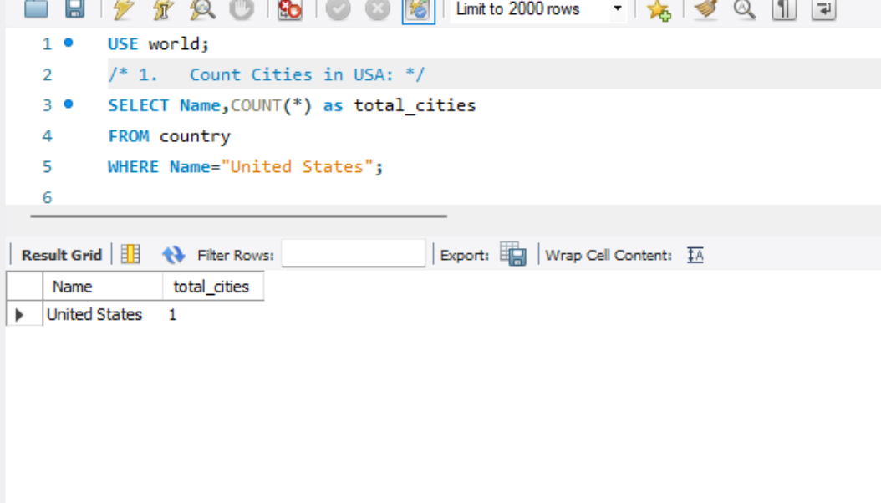
Count Cities in USA: Determining the total number of cities within the country.

Slide 8
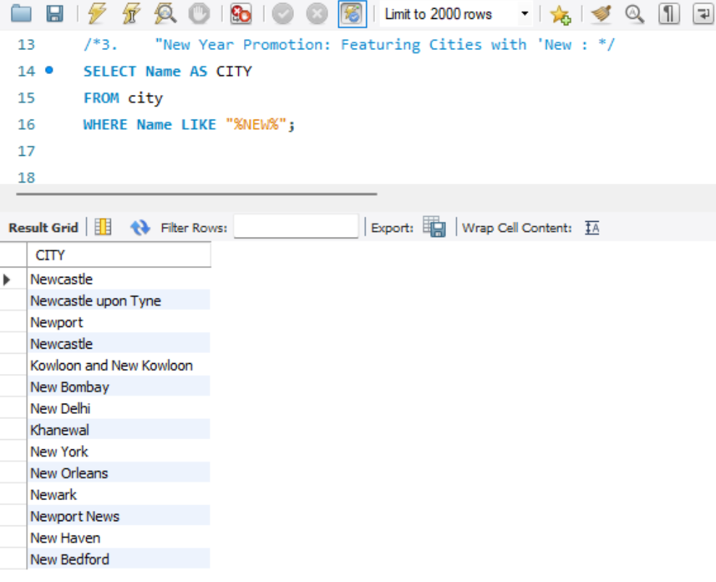
Featuring cities with names including the word 'New'.

Slide 9
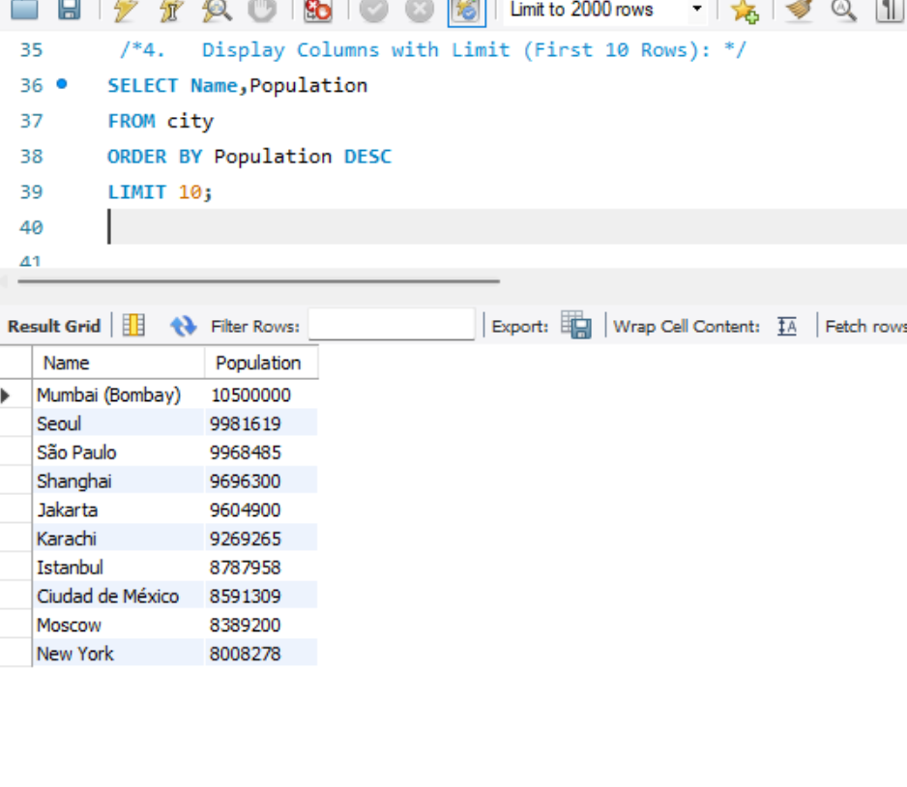
Listing only the first 10 most populous cities in the world from the database.

Slide 10
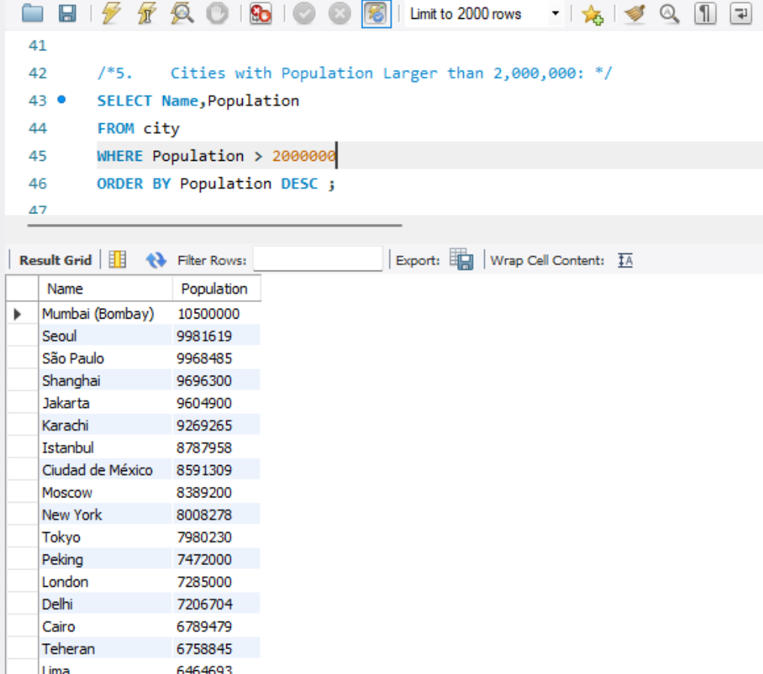
Identifying cities from the database with populations exceeding 2 million.

Slide 11
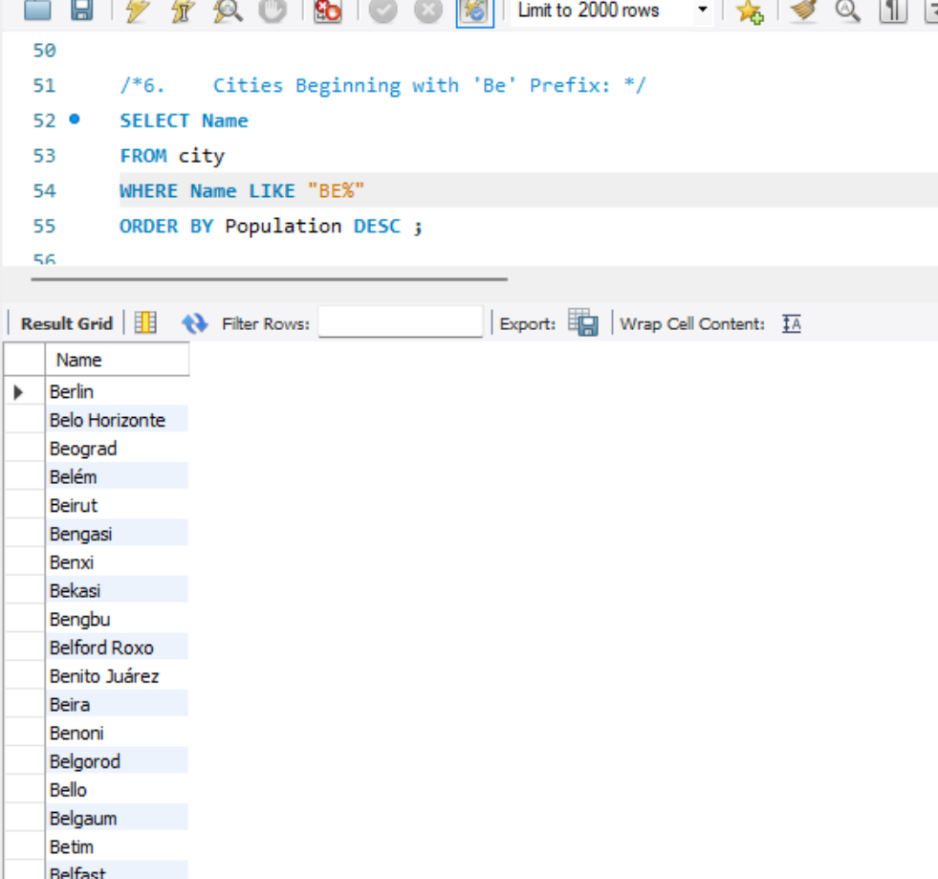
Compiling a list of cities from the database that start with the prefix 'Be'.

Slide 12
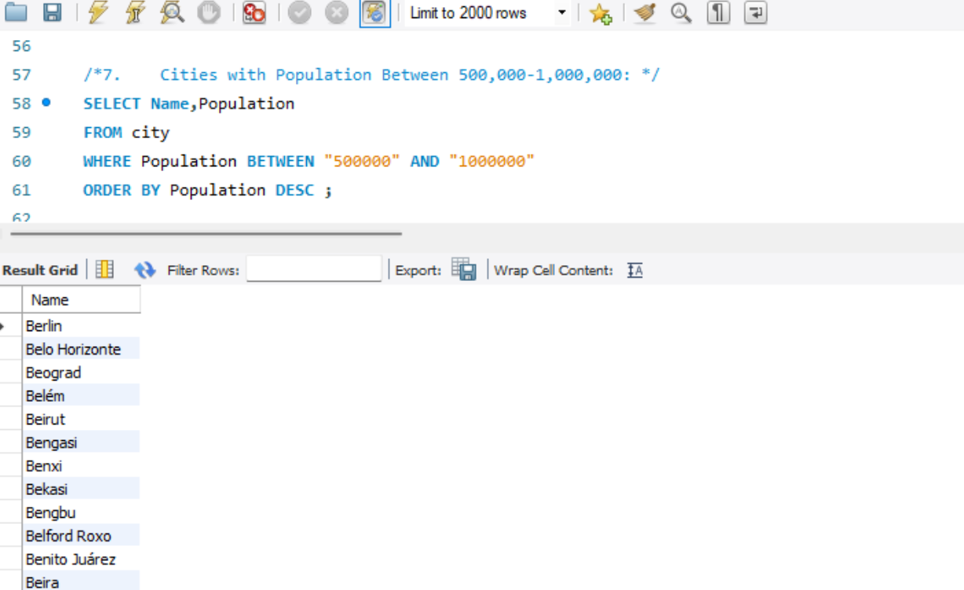
Identifying cities with populations Ranging between 500,000 and 1 million.

Slide 13
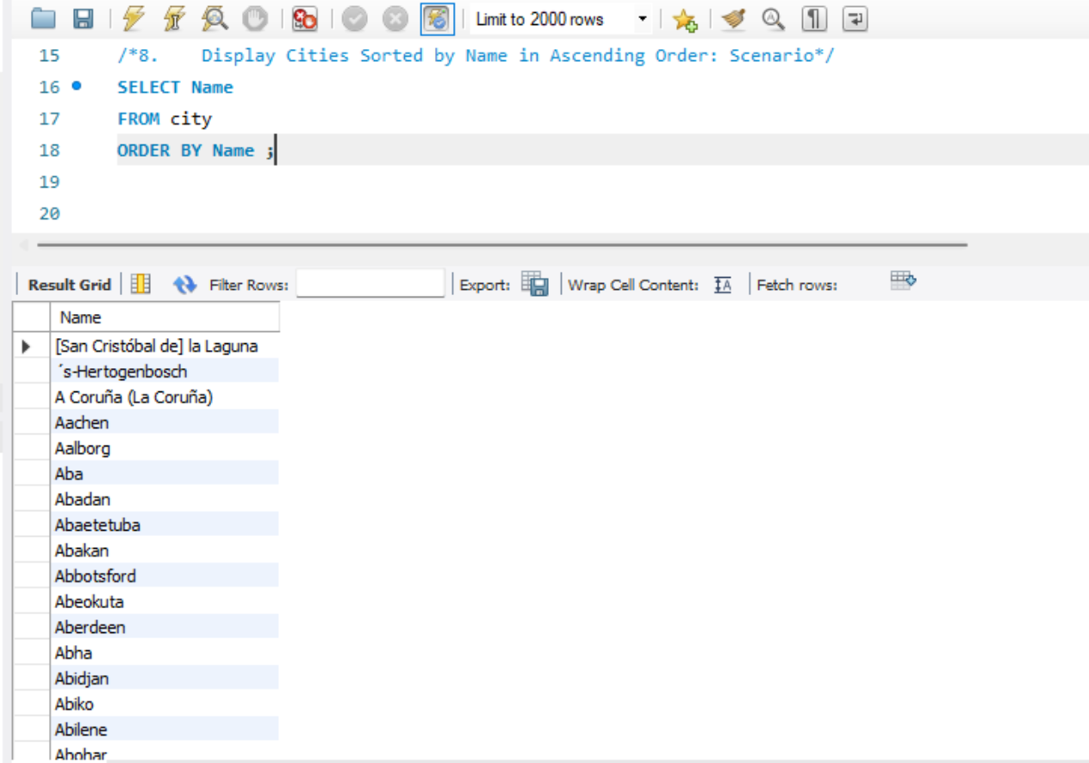
Sorted list of cities from the database in ascending order by name.

Slide 14
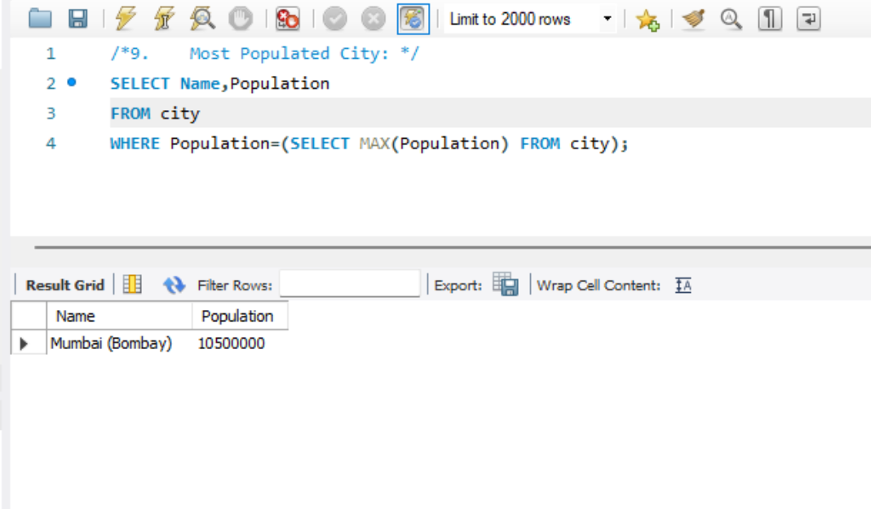
Identifying the most populated city from the database.

Slide 15
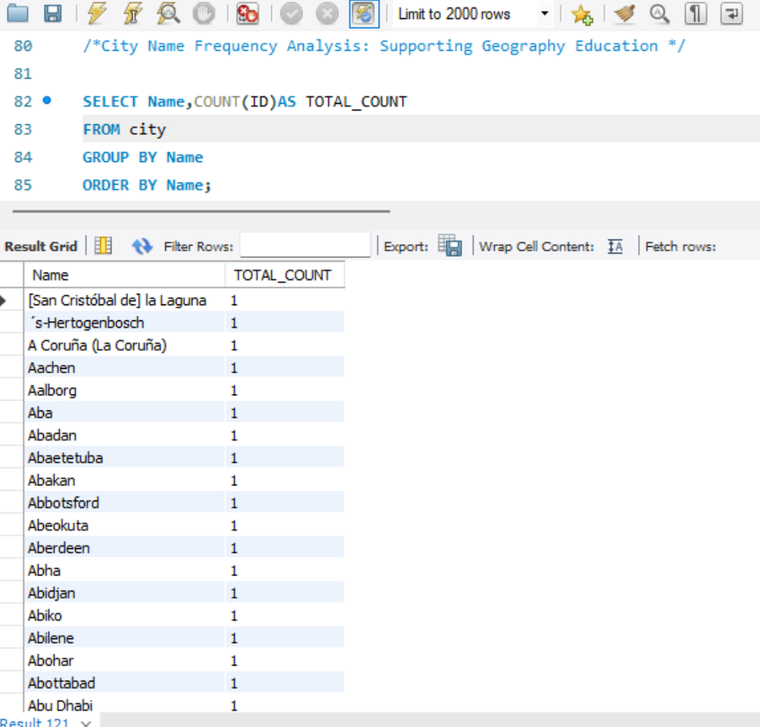
Identifying students with a list of unique city names sorted alphabetically.

Slide 16
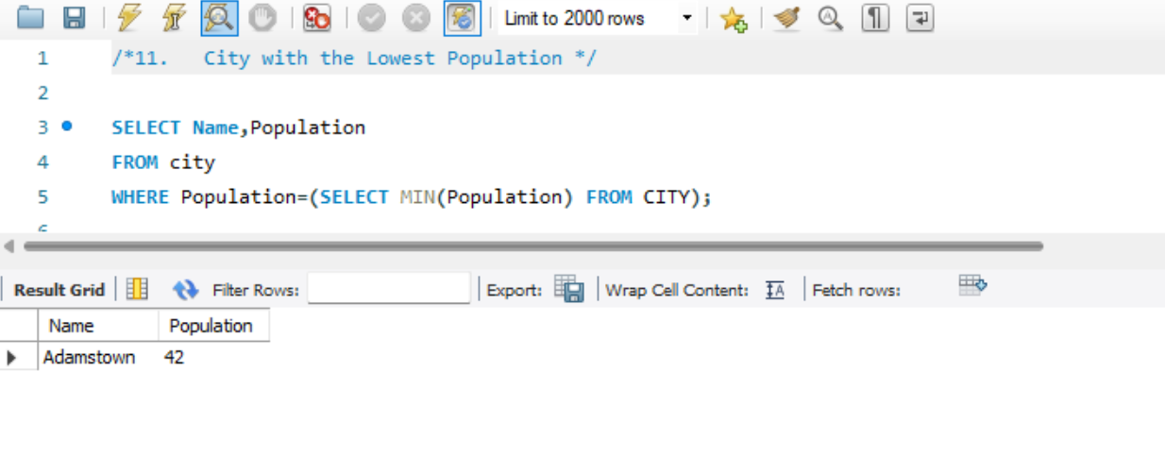
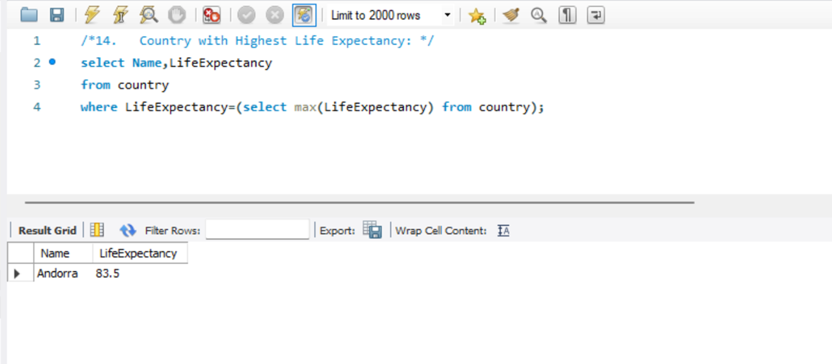
Identifying the city with the lowest population from the database.
Identifying the country with the highest life expectancy from the database.

Slide 17
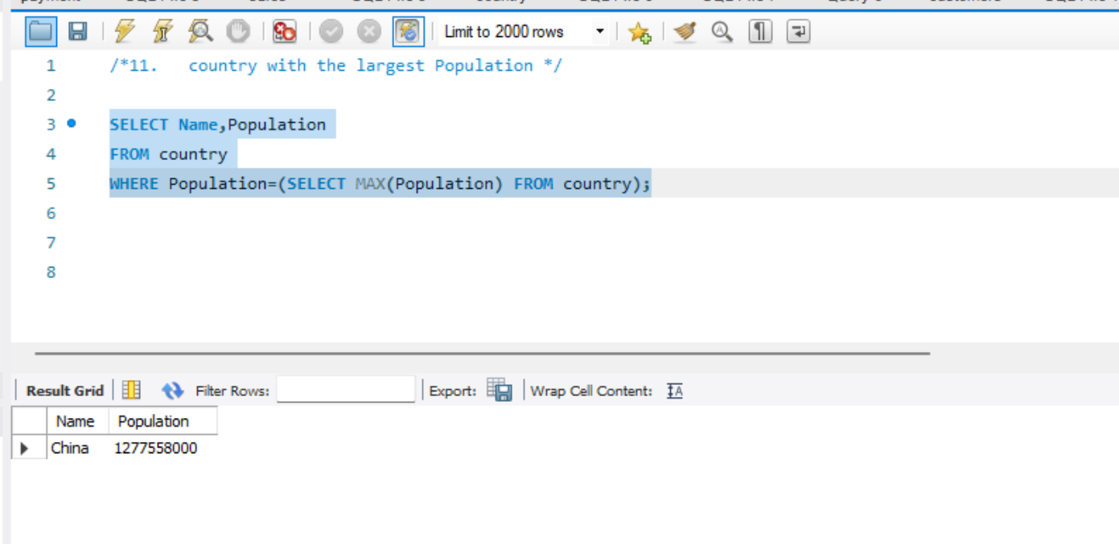
Identifying the city with the lowest population from the database.
Identifying the country with the highest population from the database.

Slide 18
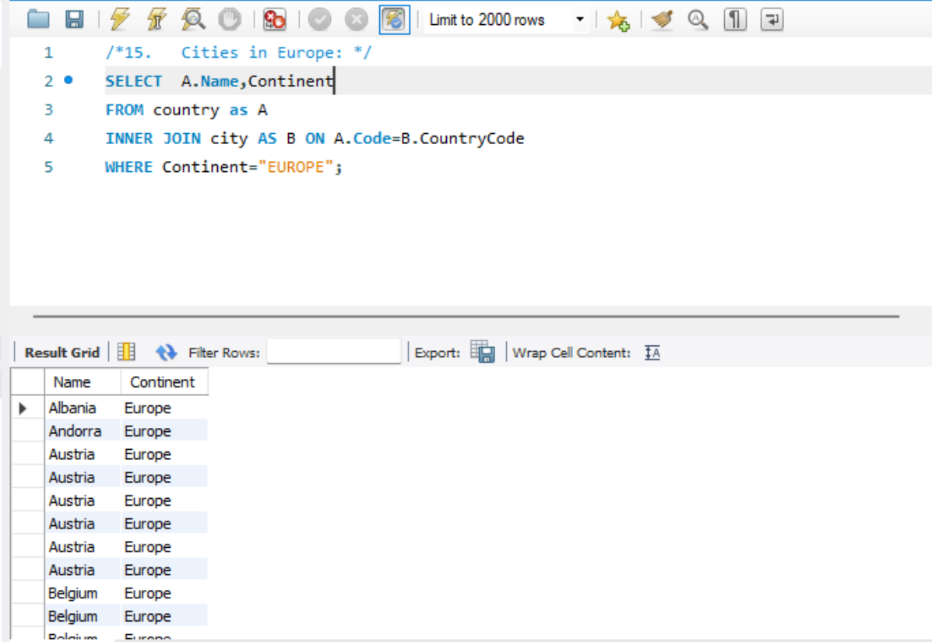
Compiling a list of cities located in Europe from the database.

Slide 19
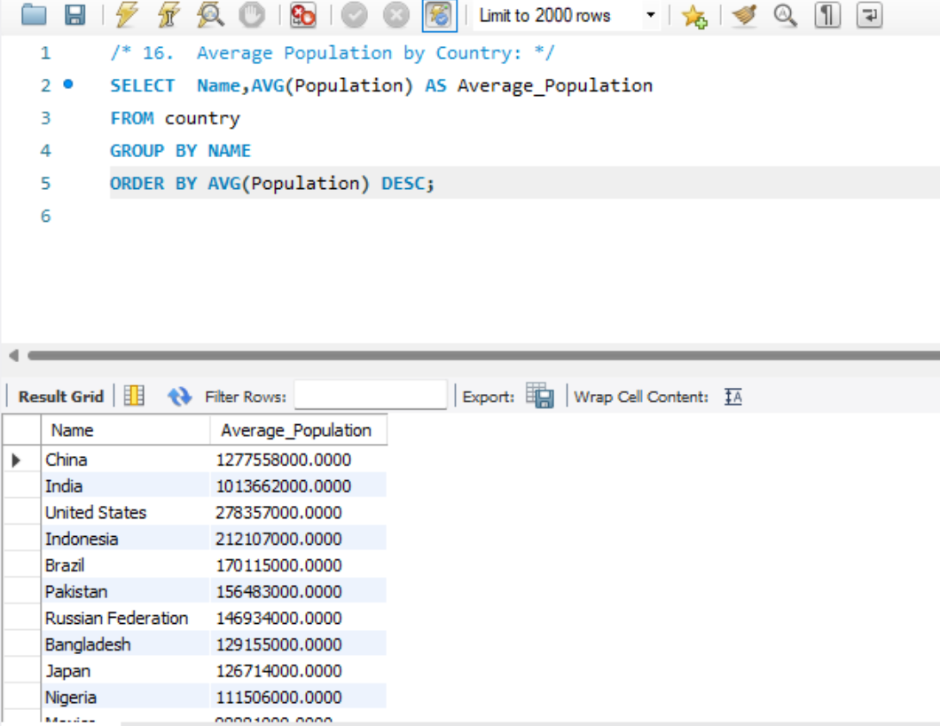
Calculating the average population for each country from the database.

Slide 20
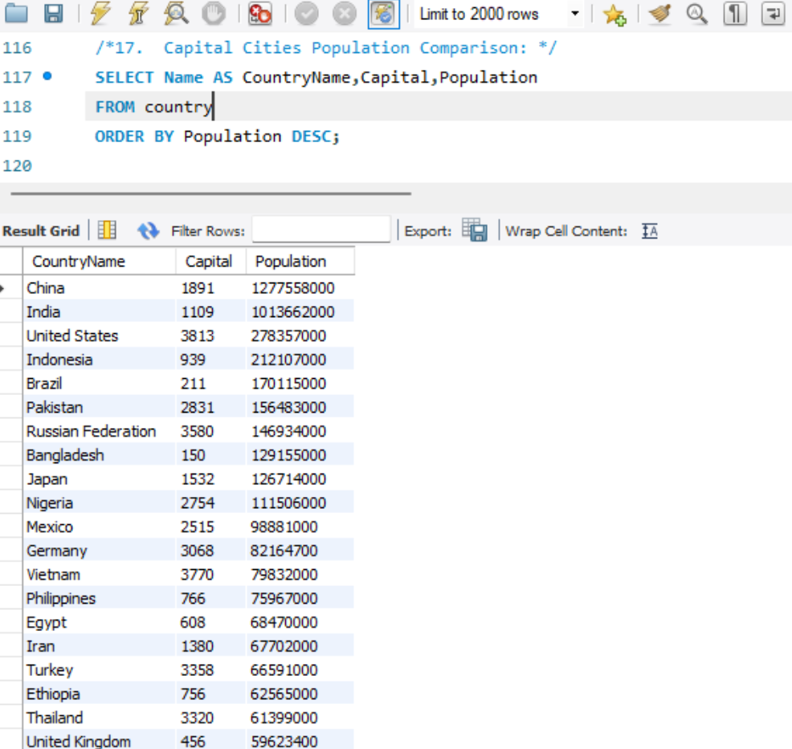
Comparing the populations of capital cities from different countries.

Slide 21
Comparing the populations of capital cities from different countries.

Slide 22
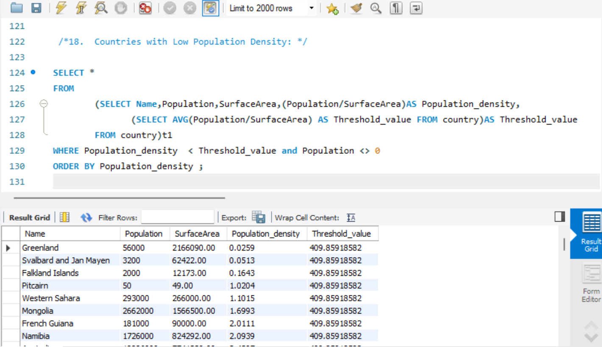
Identifying countries with sparse populations from the database.

Slide 23
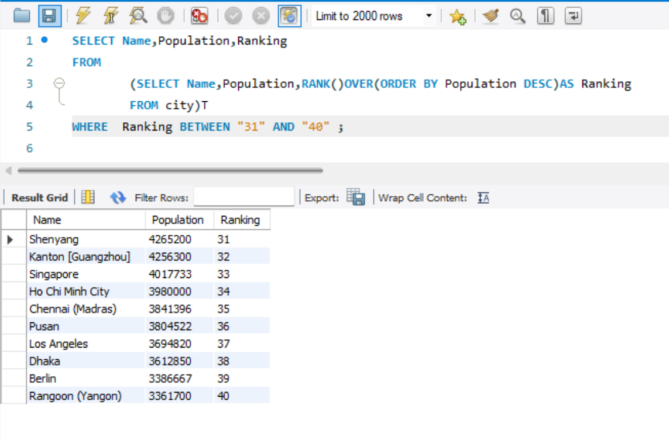
Providing data on cities ranked between 31st and 40th by population.

Slide 24
Thank You

